Slide 1
Back to School Night 2024-2025
Please find your child’s seat. Log in to their computer. Their username and password are provided next to their computer. Please login and follow the directions on the paper provided! Please raise your hand if you need assistance.
SECOND GRADE
TRACK D
Notes:
1

Slide 2
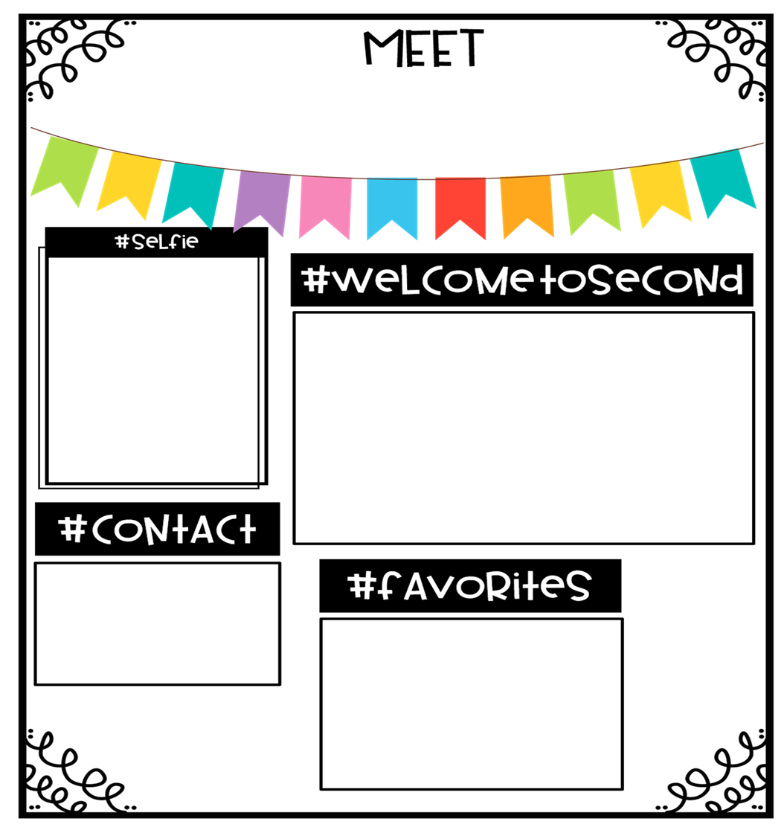
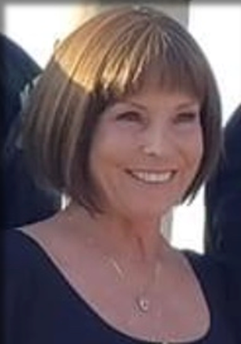
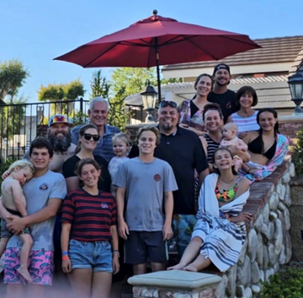
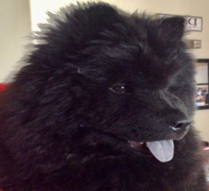
Professional Experience *Bachelor of Arts, Cal Poly Pomona Master of Science, California State University Fullerton
Educational Experience 2nd Grade 4th Grade Special Education ELD Sheltered Class Mentor/Master Teacher
Mrs. Atherton
This is my 29th year teaching in the CVUSD. I spent the first 15 years teaching Special Education and fourth grade and the last 14 years teaching second grade. I am an alumni of Whittier High School, Cal Poly Pomona and Cal State Fullerton. I have been at Cal Aero since it opened, and every year has been filled with excitement and challenges. These are unprecedented times, but our flight plan is ready. Together we will soar to new heights as we adapt to new ways of doing things and having fun as we learn and succeed together. Second grade Aviators, we are ready for take off!
Big Bear Lake
Beach/Pool
Starbucks
Jersey Mikes
Panda Express
In –N-Out
Candy & chips
to Share
Dollar Tree
Walmart
Nordstrom's
Parent Square
Email
mari_Atherton@chino.k12.ca.us
Nala!

Slide 4
Goals for the Year
Provide a safe, fun-filled, nurturing learning environment where children thrive.
Have every student reach or exceed Common Core State and District standards.
Increase each child’s academic success in all subject areas.
Develop students’ organizational skills and sense of responsibility.

Slide 5
McGraw-Hill Reading Wonders
ELA Curriculum
Focus will be on:
Vocabulary Instruction
Reading Comprehension Skill Development
Phonics
Spelling
Grammar
Writing
Writing Domains:
Informational
Narrative
Opinion
Online Access:
Online access for students and parents can be found on your child’s ClassLink account.

Slide 6
Math Curriculum Savvas Envision Math
Focus will be on:
Operation and Algebraic Thinking
Numbers and Operations in Base Ten
Measurement and Data
Geometry
Supplemental programs utilized daily on Chromebooks in class.
Prodigy
Xtra Math
eSpark!
Online Access:
Online access for students and parents can be found on your child’s ClassLink account.

Slide 7
Other Core Subjects English Language Development (DELD)​ Remediation, Intervention & Enrichment​ Social Studies- Houghton Mifflin-NGSS​ Science- NGSS​ TWIG Click 9 9999999 P.E. – Daily -Appropriate shoes​ Music- Once a week. ​ Library-Once of week.

Slide 8
Homework-Flight Plan
Homework will be posted on
Parent Square and Google Classroom.
District guidelines are 20-30 of focused minutes daily as well as an additional 20 minutes a day of outside reading.
Homework will be assigned Monday through Thursday.
1. Read: 20 minutes.
2. Reading Log. Due every Friday.
3. Math: Math workbook will be kept at home. Complete
the homework page that matches the lesson.
The day before a test a Practice Test will be sent home.
On the day of the Topic test there will be no homework.
Practice math facts 10 minutes daily.
4. Unfinished classwork.
5 Test prep when necessary.
Notes:
8

Slide 10
Grading Policy
All grades are a combination of class work, tests, quizzes, class participation, homework, and/or teacher observation.
Notes:
10

Slide 11
Grading Scale
Grade/Number | Meaning
4- Excelling | Student is at the Excelling level of performance. They have an in-depth understanding of grade level performance standards expected at this point in the school year.
3- Achieving | Student is at the Achieving level of performance. They are consistently meeting the grade level performance standards expected at this point in the year.
2- Progressing | Student is at the Progressing level of performance. They are partially meeting the grade level performance standards expected at this point in the year.
1- Beginning | Student is at the Beginning/Standard Not Met level and is not yet meeting grade level performance standards expected at this point in the year.
Standards Based Grading Report Card, resulting in students receiving the grades of 1, 2, 3, and 4.

Slide 12
Classwork
It is important that each student completes his/her classwork.
If classwork is not finished in the time allotted, the student may choose to complete it at during recess or at home.
Please check your child’s “ Take Home” folder daily.
Notes:
12

Slide 13
Absences
Please make sure your child is in school unless ill.
ATTENDANCE COUNTS!
Please try to schedule appointments after school. If you are taking your child out of school, please let me know ASAP. Work missed will need to be completed.
Missed tests will be given the next day the student returns or when time permits.
TARDIES do count against perfect attendance!
Notes:
13

Slide 14
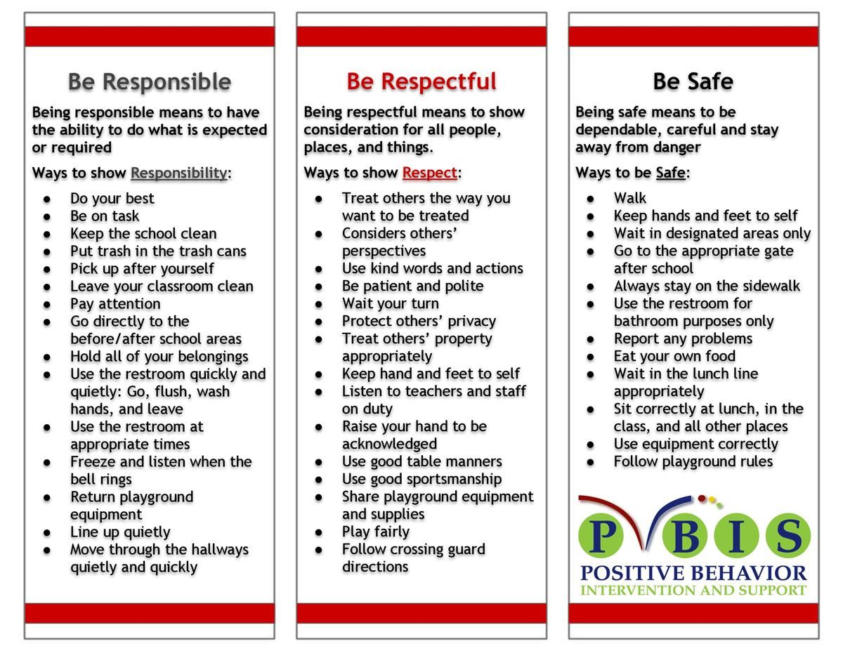
School Wide Behavior Expectations
Rick Morris Behavior Demonstrates exemplary behavior hone call home, email, or notification on daily behavior calendar.

Slide 15
Incident Logs
Incident Logs are used for OUTSIDE minor playground offenses.
Examples: running before, during, or after school, pushing, playing after bell, using bathroom after the bell …
Parent signature REQUIRED
Grades 1-6
Incident Logs will warrant the following consequences (per trimester):
1st: Warning
2nd: Loss of a recess and citizenship grade on the report card lowered one level
3rd: Office referral for 1 lunch detention
4th: Parent/Student/Teacher Conference with an Administrator

Slide 16
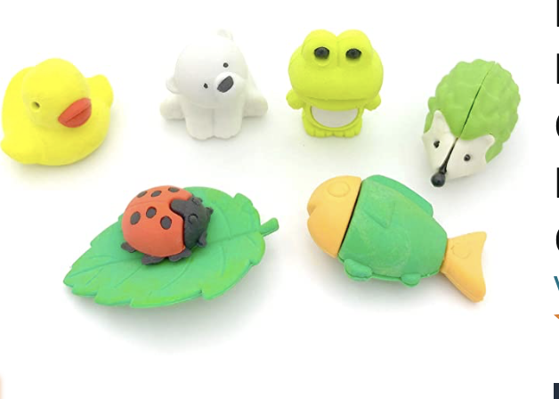
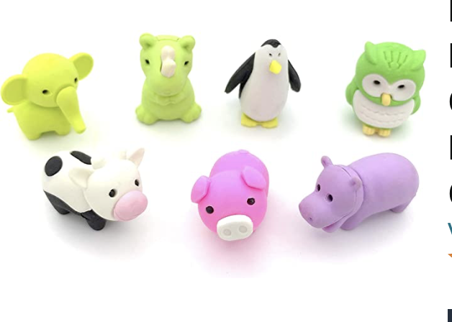
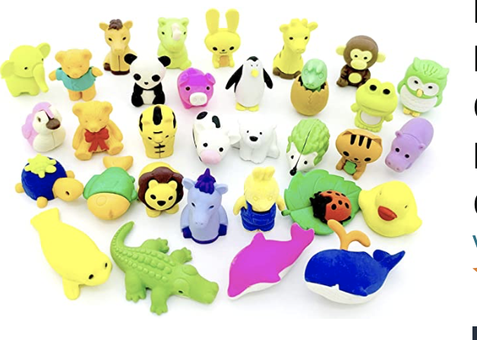
Behavior Expectation Rewards
Student’s will earn AIM High points for positive behavior both in the classroom and on the playground.
Students will be able to redeem points to purchase DESK PETS!

Slide 17
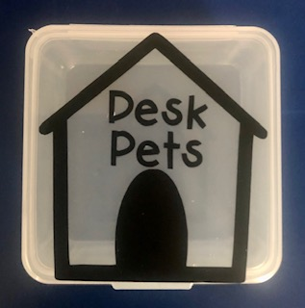
How does my student earn a Desk Pet?
Follow directions quickly.
Be kind with words and actions.
Be ready to learn and have all necessary materials.
Stay focused in line. Walk with a purpose.
Stay on task and complete class work.
When students do these things, they can earn up to 25 points a week! “Jack’s Pet Shop”
will be open approximately once a month.
Students can buy; pets, accessories, food for their pets, & supplies to build their pet’s habitat.

Slide 19
Student Recognition
There will be 3 awards assemblies this year.
Top Flight
Captain
Lieutenant
Perfect attendance
(no absences, and no more than 2 tardies or leaving school early)

Slide 20
We’re College Bound!
University of Hawaii
Wear College Bound shirt every Monday, when available.
Aviator shirt on Fridays!
Notes:
20

Slide 21
Birthdays will be celebrated in class with a birthday song and dance as well as a book. Treats and or treat bags are great. (no cupcakes please.) They must be sent with your child. They may not be dropped off in the office. Birthday party invitations can only be given out before/after school, off campus, unless the entire class is invited. No balloons please.
Happy Birthday!

Slide 23
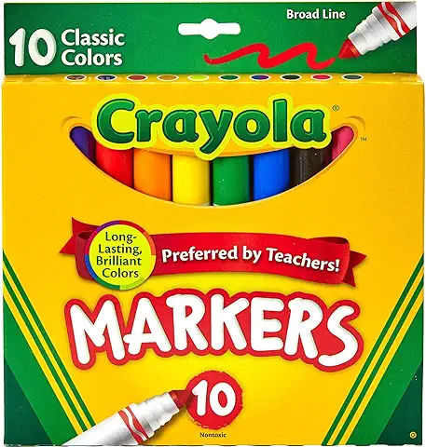
School Supplies
.
Please keep extra school supplies at home and replenish supplies as needed throughout the year.
Pencils
Colored Pencils,
Markers
Glue Sticks, etc.
Notes:
23

Slide 24
Classroom Donations
Unscented baby wipes
Flair Pens
Fun Friday Treats
Treats-snack size
White copy paper
Pencils
Glue sticks
Amazon Wish List
Amazon Card (for supplies)

Slide 25
Join the PTO !!

Slide 27
Volunteer Opportunities
Room Parent/s
Meet the Masters (4)
cut
copy
laminate
organize packets
separate math lesson papers…
Most of these can be completed at home. I will send home with you child or you are welcome to pick it up and drop off outside our classroom.
Please contact me on parent Square if you are interested in any of these opportunities.
Join the PTO!

Slide 28
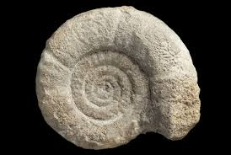
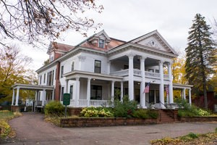
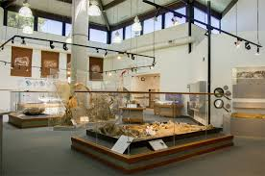
Field Trips 2024-25
Spring 25
Heritage Museum of Orange County
Social Studies
Fall 24
Clark Park Interpretive Center
Science

Slide 29
Parent-Teacher Conferences are coming up.
9/16 - 9/18
Please sign up for a date/time on Parent Square, when you receive the notification.
Notes:
29

Slide 30
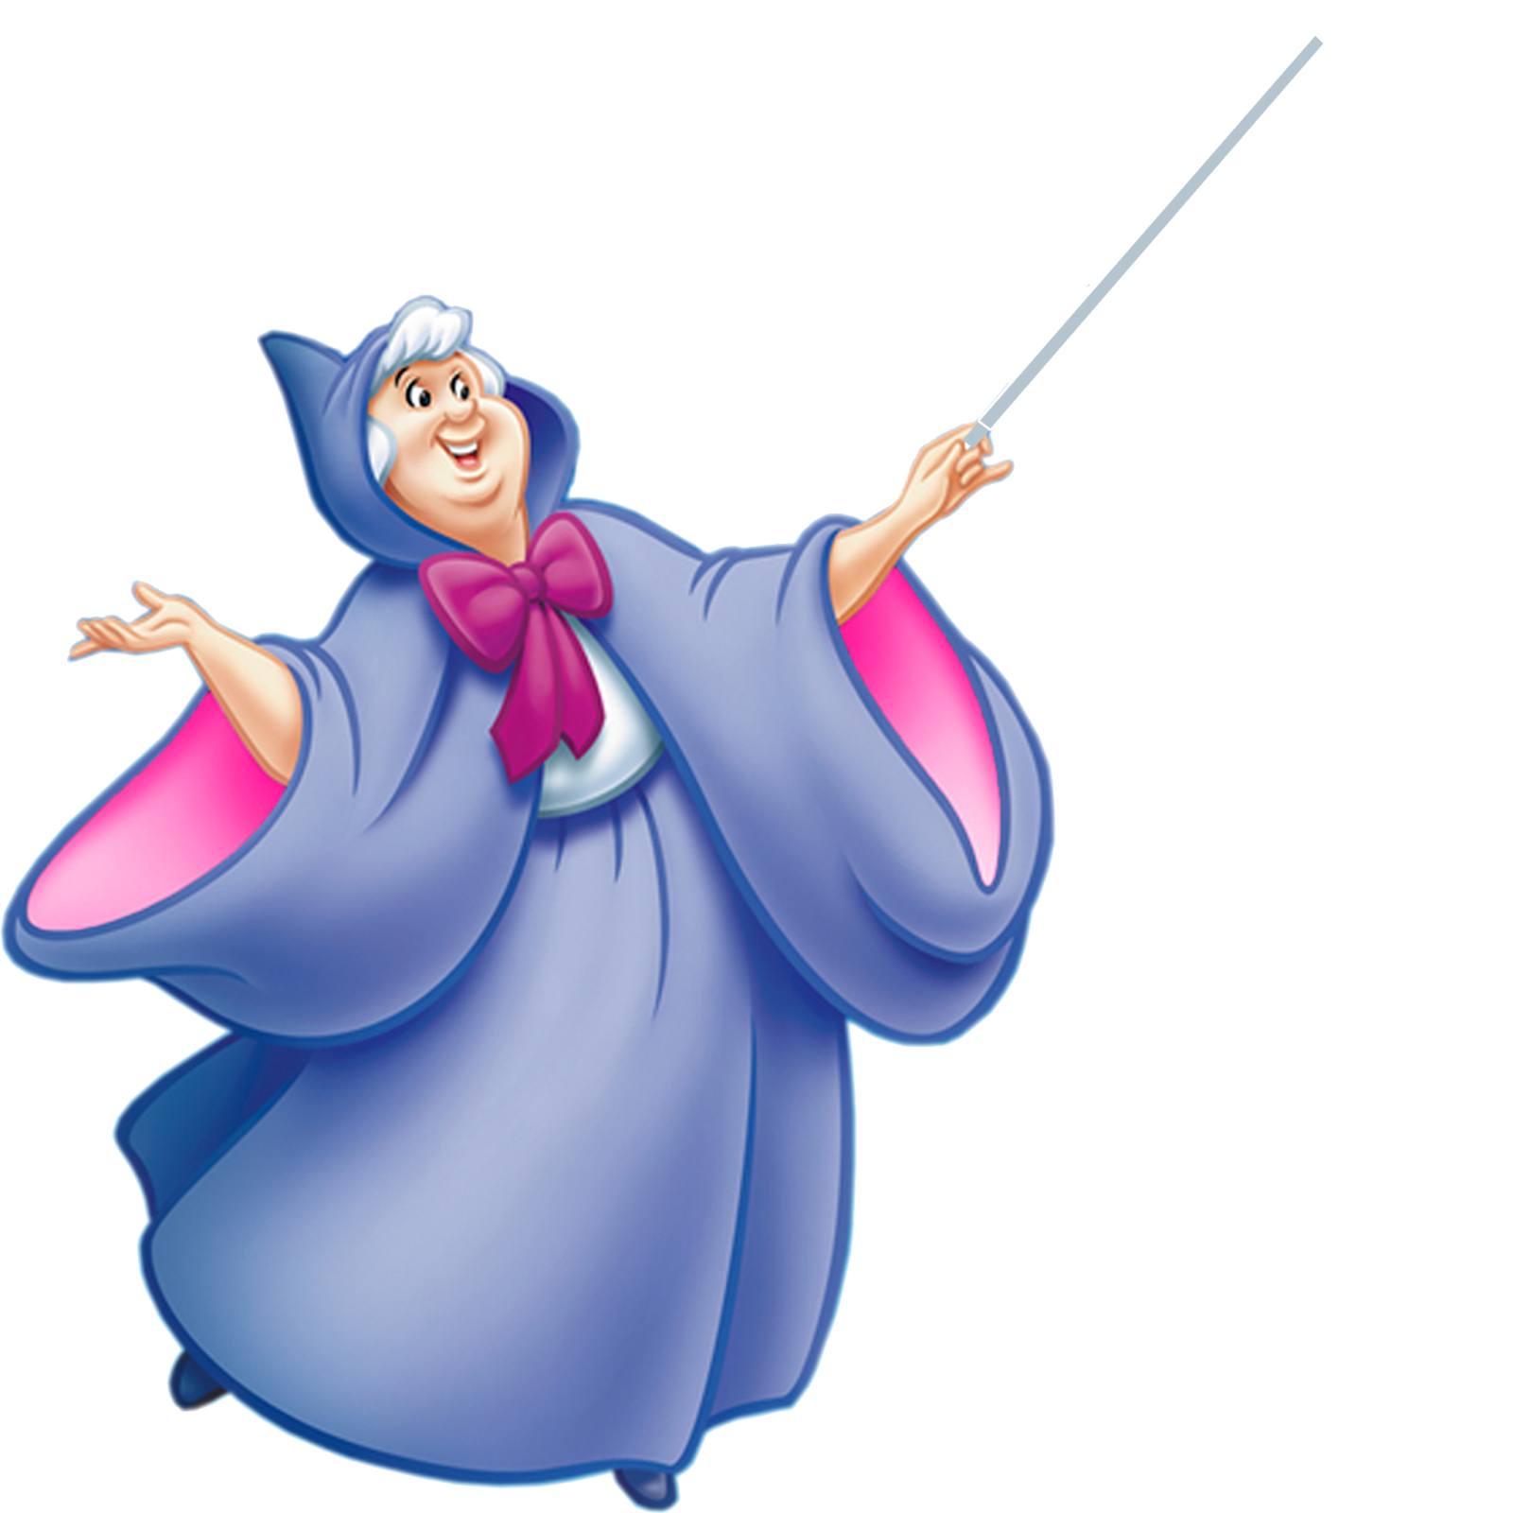
Classroom Wishlist
Amazon Classroom Wish List
https://www.amazon.com/hz/wishlist/ls/2SQRCBYMN8HAH?ref_=wl_share
@Mari-Atherton

Slide 31
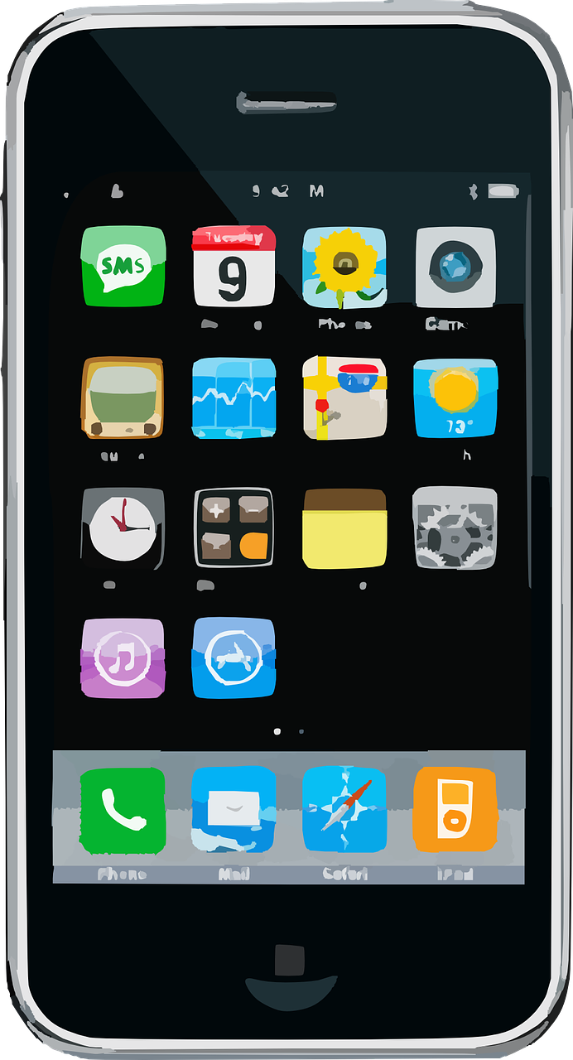
Best ways to contact me!
EMail-mari_atherton@chino.k12.ca.us
Cell- 562-695-3850

Slide 32
Contact Information
Please feel free to send me a note or an email regarding any questions or concerns.
Cal Aero Preserve
(909) 606-8531 Ext. 8810
Text Cell (562) 695-3850
mari_atherton@chino.k12.ca.us
I’m looking forward to a
terrific year!
Together we’ll soar!
Notes:
32

